Slide 1
MealMeter
Adam Aharony
Bar Katash

Slide 2
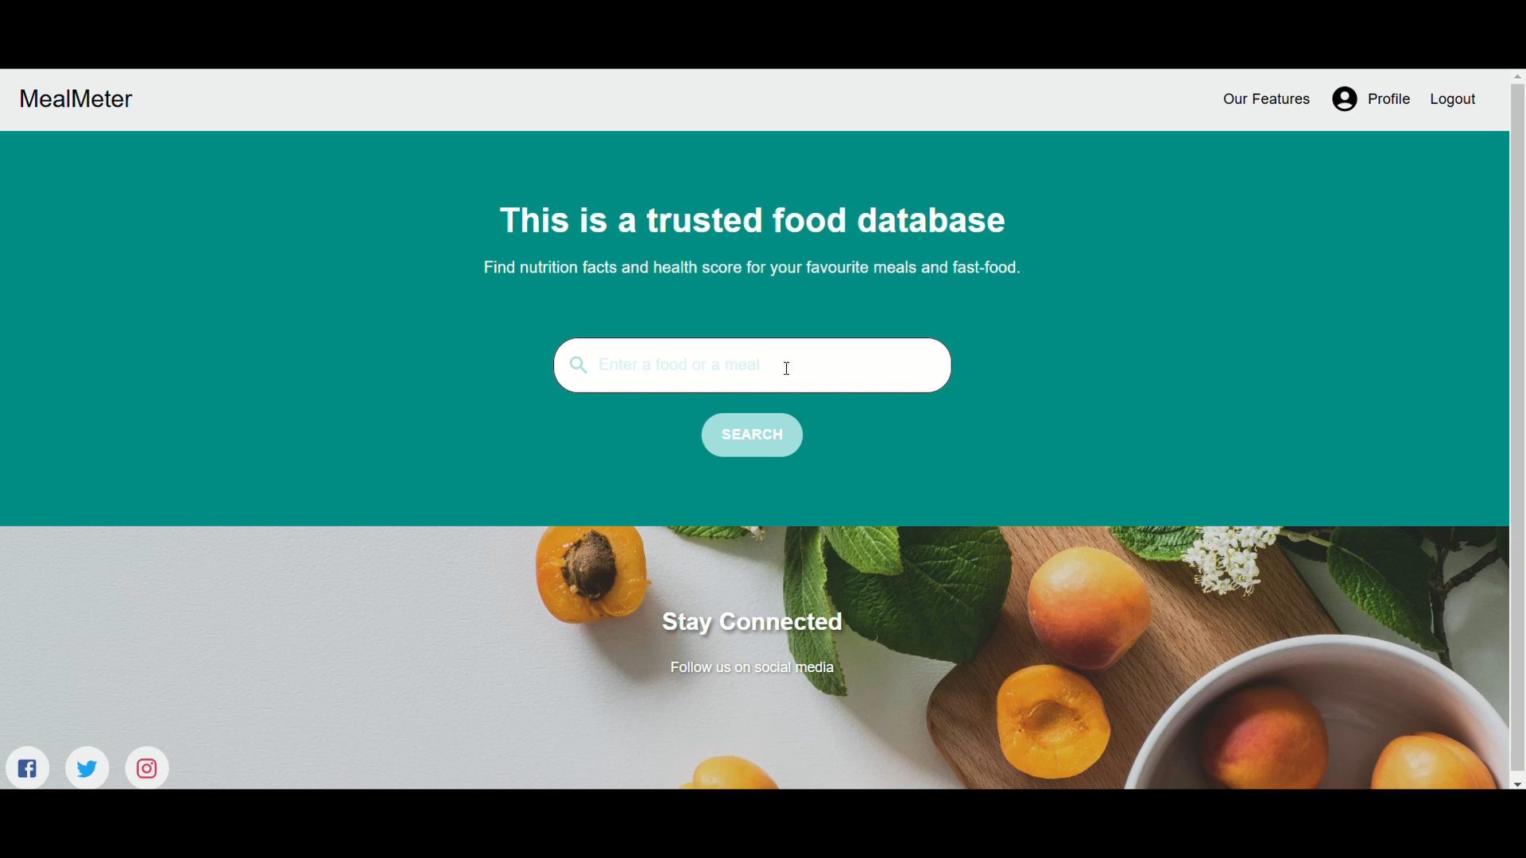
Video:

Slide 3
Behind the Scenes: Main Dataset
The main dataset was sourced from the US Department of Agriculture (USDA) and the US Food and Drug Administration (FDA), which is a federal agency under the US Department of Health.
Data Source: Food and Nutrient Database for Dietary Studies (FNDDS) page on the USDA website
Dataset Content:
Detailed nutritional information on food items
Contains data on food descriptions, weights, portions, and nutrient values
Provides comprehensive data for accurate meal analysis
Aims to provide users with detailed information (ingredients, nutrients, etc…) about the food they eat

Slide 4
Behind the Scenes: Additional Datasets
Calories Burned During Exercise and Activities:
Taken from Kaggle
Contains physical activities and their calorie burn rates
Helps users find exercise activities that can offset a desired amount of calories
Open Food Facts:
Taken from Kaggle
Contains many foods alongside their nutritional values alongside their nutritional score (UK or France)
Helps us determine importance weights for various nutrients in our dataset, and use them to provide our own nutritional score for different foods

Slide 5
Overcoming Challenges: Learning Nutrient Importance Values
Our primary challenge was calculating a health score for each food item, as this information was missing from our main dataset.
There are many ways to solve this problem: we used the Open Food Facts dataset, which provides nutrition scores for various food items based on their nutritional values, aligning with our needs.
However, the foods didn’t match those in our dataset. To overcome this, we trained a linear regression model to calculate importance weights for each nutrient.
Using these weights, we successfully computed and saved health scores for the foods in our dataset.

Slide 6
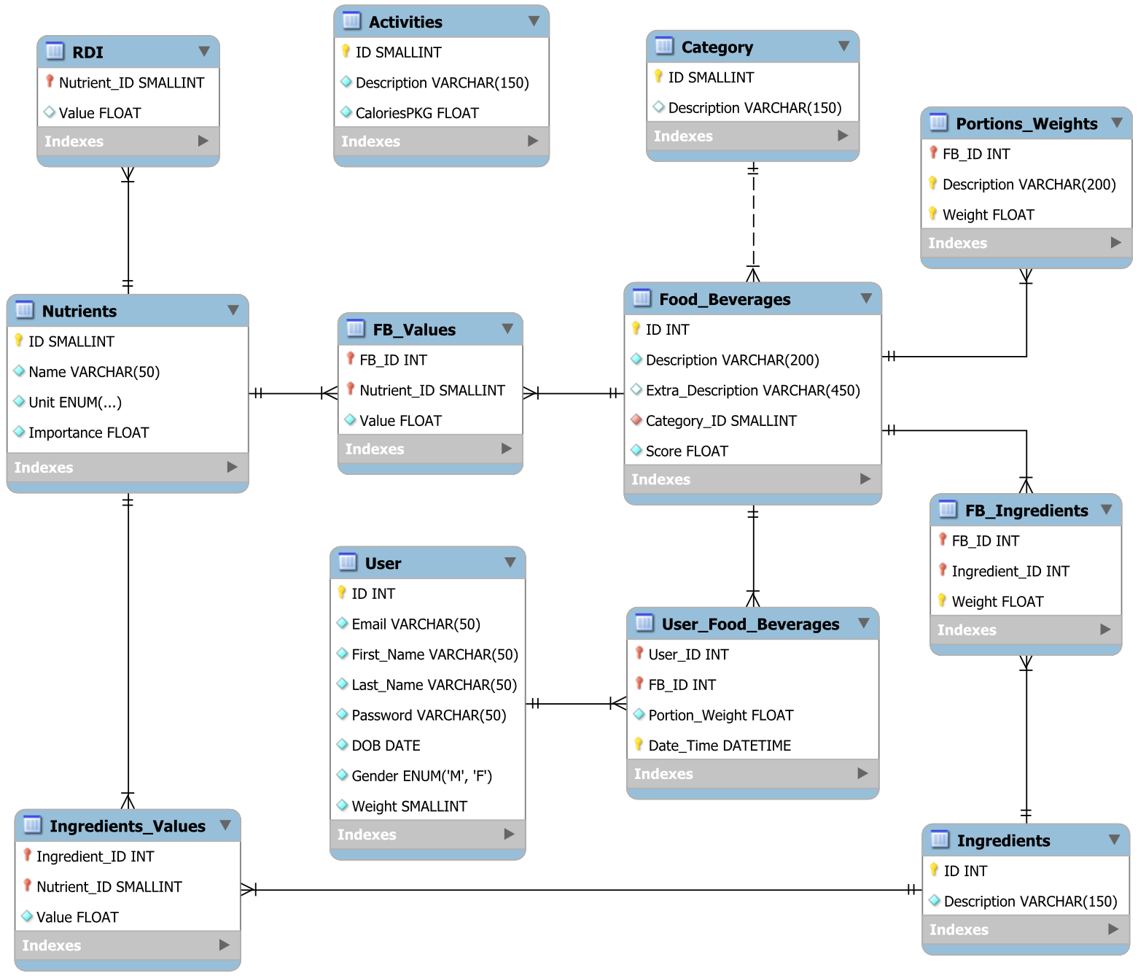
Schema Diagram:

